Slide 1

Final Project – DERIV2D
COSC 6364 – Advanced numerical analysis
By: hai-y Michael Tran Nguyen – 0925358
5/10/2018

Slide 2
Introduction
The goal of this project is to extract derivatives and gradients of multidimensional functions and compare them. Specifically, we will numerically calculate the directional derivative of a Function A and compare it to another Function B (which is already the derivative). In this project, we will be doing this on 2D functions.

Slide 3
Technologies Used
C# - MS Visual Studio 2018
Part 1 – Mainly deals with calculating the derivative and generating and outputting the raw data (.csv) used for comparison in part 2
R – R Studio
Part 2 – Mainly deals with running comparison and creating graphs based on the raw data generated from Part 1

Slide 4
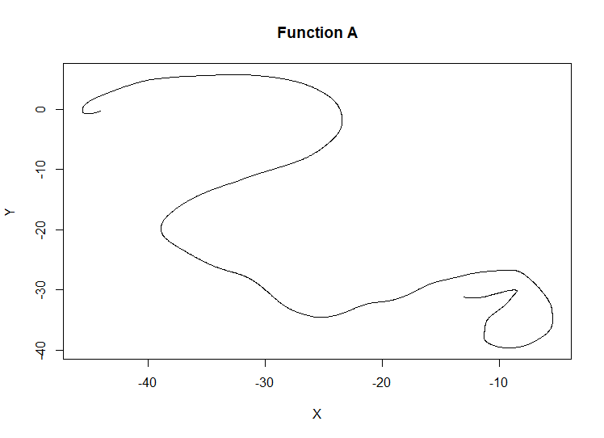
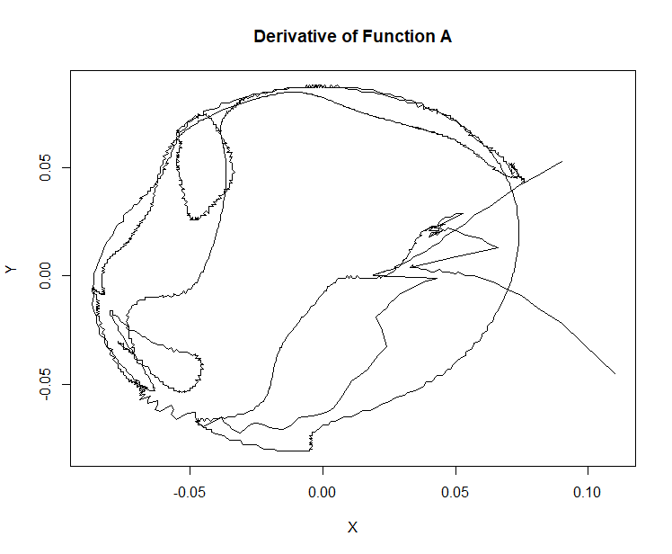
Function A Graph

Slide 5
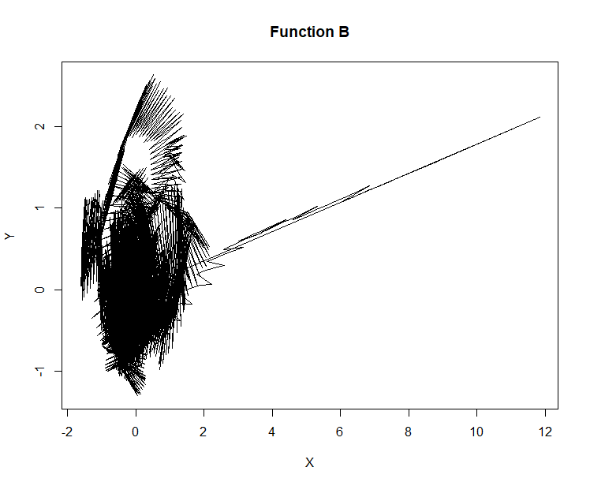
Function A vs Function B
Difference in general shape and scale
Derivative of Function A and Function B differ substantially

Slide 6

Methods – Part 1 (C#)
Derivative Algorithm ($NextPoint−CurrentPoint$)
Normalization (Absolute maximum value)
Generating Comparison Data
Static Steps Method 1 (SSM1)
Static Steps Method 2 (SSM2)
Dynamic Steps Method 1 (DSM1)
Dynamic Steps Method 2 (DSM2)
M1 – By Function A coordinate
M2 – By Function A average coordinate
Static – Set number of steps per iteration in Function B per step in Function A
Dynamic – Dynamically choose number of steps per iteration in Function B per step in Function A

Slide 7
Methods – Part 2 (R)
Generate Graphs
By-axis Differences and Comparisons
By Magnitude and Degree (Calculated)
Get mean values

Slide 8
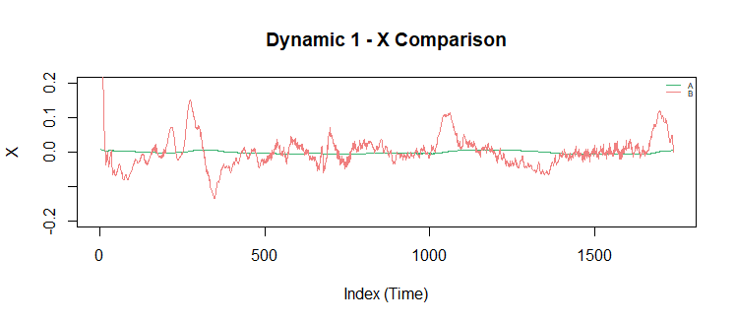
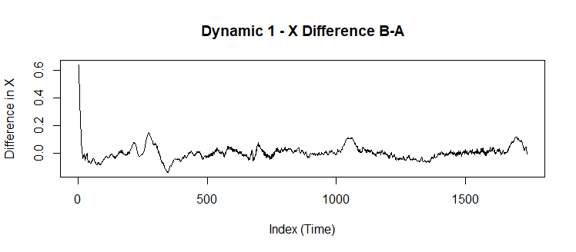
Results – DSM1
Function A had much smaller differences than Function B
Function B changes at a much more rapid pace
Function B looks like it has a lot of noise

Slide 9
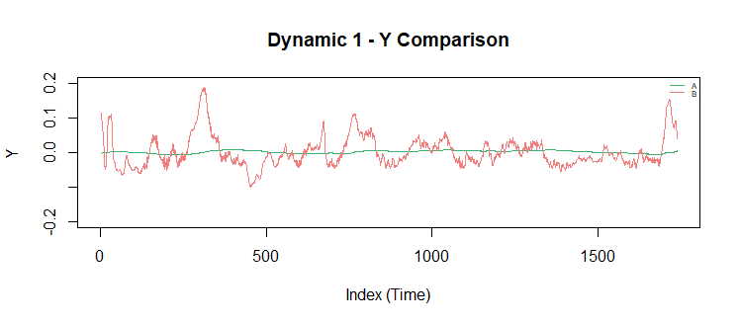
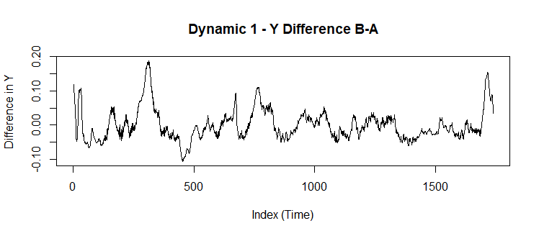
Results – DSM1

Slide 10
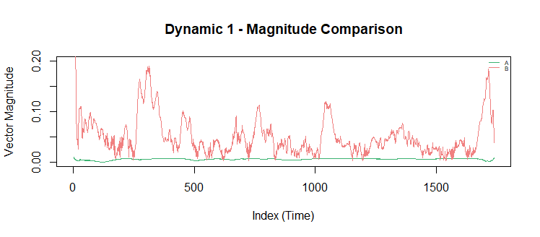
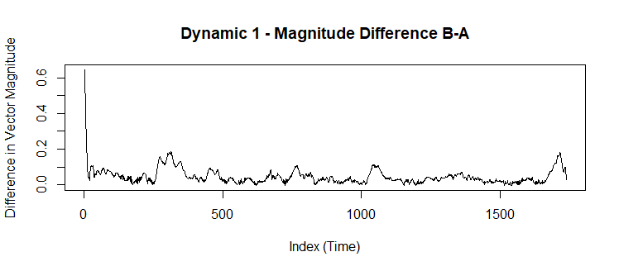
Results – DSM1

Slide 11
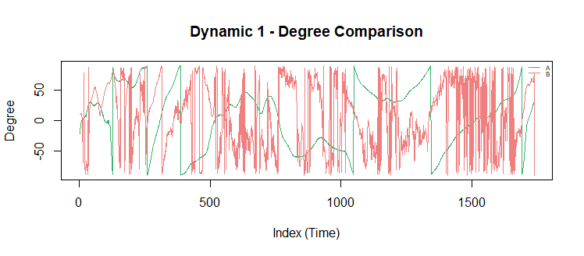
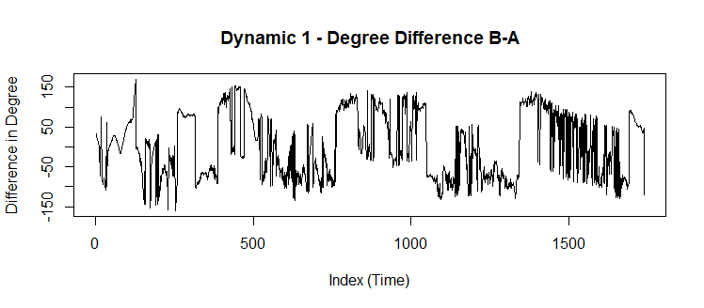
Results – DSM1
Function A had more fluctuation for degrees
Function B still had a lot of noise happening

Slide 12
Results – Overall Mean
Method | Mean of Difference of X | Mean of Difference of Y | Mean of Difference of Magnitude | Mean of Difference of Degree
SSM1 | -0.000519901 | -0.002764169 | 0.04402508 | 1.611708
SSM2 | -0.0005176885 | -0.002753617 | 0.04404393 | 1.661593
DSM1 | 0.002816749 | -0.00092656 | 0.04543144 | 2.710786
DSM2 | 0.002818639 | -0.0009473579 | 0.04543719 | 2.971562
SSM1 and SSM2 were relatively the same
DSM1 and DSM2 were relatively the same
SS vs DS was a big difference

Slide 13
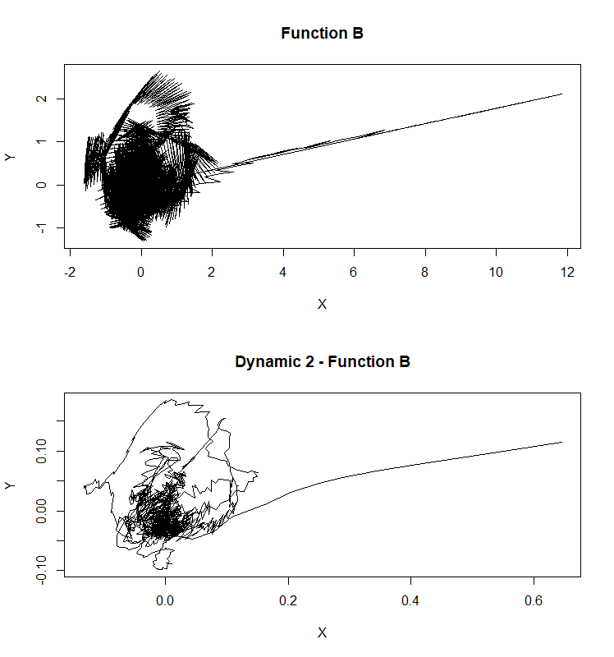
Reducing Noise
The comparison methods reduce the noise of the data when run
Smoother
Retains same shape

Slide 14
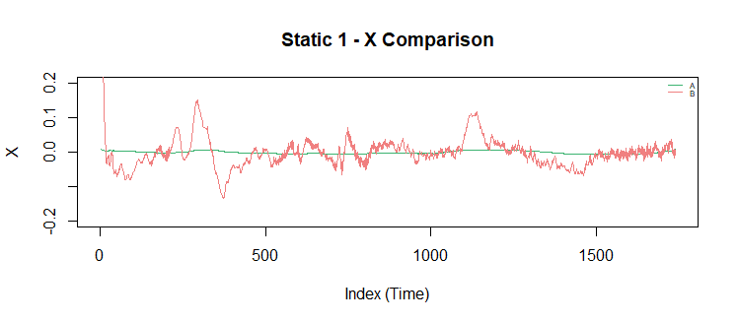
Static vs Dynamic
Static steps caused error propagation
SSM1 skipped 637 points
SSM2 skipped 642 points
Dynamic steps reduced error propagation
DSM1 skipped 0 points
DSM2 skipped 0 points
The graphs shows how the far right part of the graph for B was cut off in static vs dynamic

Slide 15
Conclusion
Derivative of Function A was very different from Function B in almost all aspects
Derivative of Function A had less fluctuations in its data
Function B seemed to have a lot of noise (even after reducing it)
4 Methods used to compare the data
Axis, Magnitude, Degree was compared
Static methods simpler to implement, but error propagation (does not use all points available in Function B)
Dynamic methods harder to implement, but reduces error propagation (uses all points available in Function B)

